Slide 1
Senior Seminar in Peace and Conflict Studies
Our Aqueous Exigence:
Establishing a Narrative For The Great Lakes Basin Commons
by Rob Woodworth

Slide 2
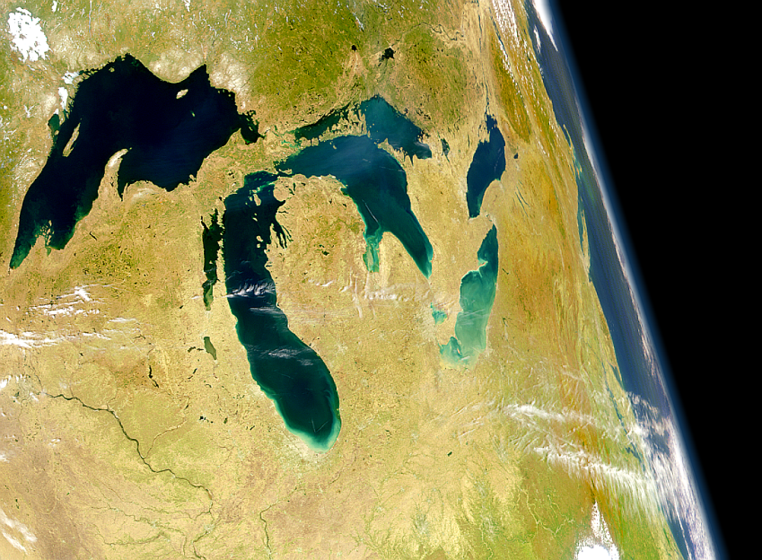
Overview
The Great Lakes Water Basin is the single largest network of freshwater in the world—it provides life and vitality for over 40 million people that live both near and far from it’s extensive shorelines.¹ These waters have a unique importance considering they are shared by the United States and Canada among eight states and two provinces.
For surrounding communities and ecosystems, the Great Lakes basin and its tributaries are essential for a myriad of reasons: drinking water, sustaining agriculture, driving weather systems, protecting biodiversity, generating electricity, supporting industrial production, developing new infrastructures…the list goes on. Having access to the natural resources held in the Great Lakes is certainly a very powerful tool—thus there are many interested parties looking for an equitable share.
.
Notes:
1 – Maude Barlow, Blue Gold

Slide 3
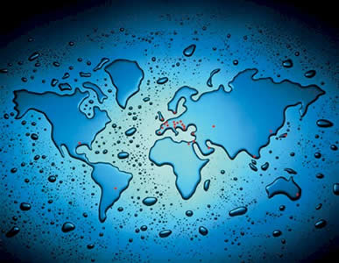
Overview II
A body of water this size has significant economic possibilities, serious political and geographical obstacles, and legions of ecological consequences. With all of this in mind, it is safe to say that regulating the lakes and how they are used is an extremely difficult task. Affairs have been moving smoothly for the most part, but now a public outcry has emerged calling for a new narrative (read understanding) surrounding the lakes and all they offer…

Slide 4
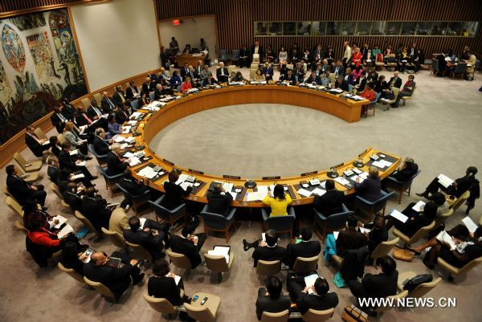
Overview III
Maybe move timeline up to here? Also include more examples of current negative aspects such as Loss of biodiversity, invasive species, other environmental and humanitarian issues.
The outcry calls to establish a legal and political framework that would establish the Great Lakes Basin as a commons that is shared by the people, as well as deem it a protected bioregion. This outcry is a response to many various factors within the conflict, but it is clear that there are two primary parties who have emerged from the debate; those who are calling for change, and those who wish to keep things the way they are. As you will soon see, these various groups have very different reasons for holding the positions they do. But one thing is for certain: contention around this topic is extremely thick.

Slide 5
Commons Approach vs. Current Approach
The two primary sides in this conflict have fundamentally different intrinsic values that exacerbate tensions surrounding water management and allocation issues.
Namely, the newly proposed Commons approach has much different frame and overall function than the Current allocation system.
Commons
Based on Public Trust Doctrine¹: Natural resources belong to the public; no one can be denied access
Intends to create a hierarchy of use where restoration and preservation take precedence
Current
Based on Capitalist Governance & Trade Regimes: Resources are controlled by an elite and powerful few
Intends to privatize water supply and control it as a commodity in local and global markets
Frame
Function
Notes:
1- Maude Barlow Great Lakes Water Commons

Slide 6
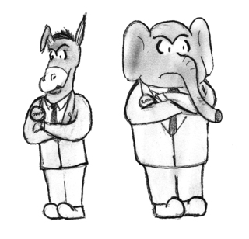
The Primary Conflict
Though radically different in methodology, these disparate strategies of water management (Commons approach vs. Current approach) are working towards a common goal: finding a way to effectively manage the world’s largest freshwater basin.
Each strategy will inherently favor certain interests over others, thus finding solutions that all parties agree on has been challenging.
However, with certain compromises and affordances, there is certainly a place where Commons advocates can see eye to eye with those who are opposed to water management reform.
Despite the fact that some are resistant to change, the need for reform seems commonsensical when you look at the current state of affairs…

Slide 7
Reasons to Consider Reform
The current state of Great Lakes water management is based on a long history of self-perpetuating exploitation. Alexa Bradley eloquently elaborates:
“For some, the Great Lakes represent a massive resource grab that takes many forms: privatization, appropriation, the entitlement to use and misuse water, and the prioritization of market economics over ecological and justice considerations. By its nature this resource grab is anti-democratic and undercuts both environmental protection and the equitable sharing of water. This exploitation makes the case for not just better water policy, but for a different kind of governances” ^{! Maude} ^{Barlow}
Current rates of appropriation and dispossession of water from the Great Lakes basin have reached record high levels – a dangerous phenomenon when you consider the ecological qualities of the lakes basin. The Great Lakes are all glacial bodies of water. This means that they do not accumulate any additional water from surrounding systems—what you see is what you get.² ^{Maude} ^{Barlow} This is a classic example of the tragedy of the commons – everyone wants access, but ensuring equality and longevity aren’t always possible.
Thus there are multi-dimensional reasons for considering reform. It stands to reason that all parties involved would like to ensure the survival of the basin, if not only to suit their needs.

Slide 8
Structural Elements of Conflict
Exacerbating Dynamics (General increase in demand)
Water Intensive Industries – many locally based steel, paper, pulp and automobile producers are heavily reliant on water.
Regional agricultural production also diverts much needed water
Widespread urban growth has increased domestic demand
Increasing Pressure on Lake Ecosystems
Water trading/exporting has brought a huge influx of invasive species
Growth of lake area industries has increased pollution dramatically
Urban/Suburban development has created a net loss of wetlands
Exploitation vs. Preservation
These are seen as the two primary archetypes of management that are in direct opposition to one another. These groups are unable to compromise.
Conflicting Points of View
Environtmental POV -- Commercial POV -- Human POV
Split Between Governance
Because these waters are shared by two Nations with two different governance regimes, the conflict has a very dynamic nature that is constantly in flux to maintain its balance.

Slide 9
Establishing a New Great Lakes Basin Commons
Third Siders
Key Parties
Key Parties
Primary Dispute
Establishing a New Great Lakes Basin Commons
Profiteers

Slide 10

Power Arenas Within Conflict
Economic Power
This power arena is built from private wealth and corporations that have secured access to private holds of water – players have interlocking systems of power.
Players in this arena include Capitalist Governments, Commercial Traders, and Exporters – as well as profiteers on either side.
Political Power
This arena is built through access to political networks, electing representatives, buying access to other arenas, and lobbying on behalf of particular water interests.
Players in this arena include Water Rights Advocates, Environmentalists, National Governments and Industrial/Commercial Developers.
State/Regional Power
This arena is built by judiciary committees, the formulation of laws/regulations, courts and legal systems that uphold those laws, and regional limits of democracy.
Players in this arena include Regional Watersheds, Local Governments and Water Municipalities.
Social Power
This arena is built through non-profits, NGO’s, or other social-service institutions that act as buffers on other forms of power – grassroots based.
Players in this arena include Water Rights Advocates, Environmentalists, and the International Joint Commission.

Slide 11
Party A – Water Municipalities
  Self Identification
These are typically self-governed administrative divisions that regulate publicly shared water sources. Both the US and Canada have municipal networks. They would likely identify as social service providers, regulating the use of a public good.
  Values, Positions, & Interests
The primary values are independence, sovereignty, transparency and equity. Their position is that water should be shared and controlled by the surrounding community, not by outside forces. This is because they are interested in securing fresh and accessible water to the members of their governing district or community.
  Needs
Their needs are typically to create and to protect; they want to create an efficient and effective regulatory body that will protect the natural resources (namely water) of the people in the surrounding community.
  Frames
Municipalities approach this conflict with the frame of ownership. They believe that water belongs to, and should be governed by, the people in the surrounding area. They have a sense of entitlement to that water.
  Grievances
The core grievance of municipalities would likely be that their independence and freedom has been jeopardized by national/state governments. They feel that they haven’t been given the authority or autonomy that they deserve.
  Internal Divisions
Being that municipal districts exist on both sides of the international border, there are innumerable divisions that exist. So for now, I suppose I could separate them as US and Canadian Municipalities.

Slide 12
Party A – Regional Watershed Districts
  Self Identification
Regional watersheds are similar to municipalities in that they are comprised of the people that live near the water source. But rather than identifying as providers, watersheds would identify themselves as stewards to the community water source. Not only do they use the water, they also have an inclination to protect it.
  Values, Positions, & Interests
The primary values of watersheds would be purity/quality, access and protection. These groups want to foster relations that allow them to keep using the water they are near without being threatened by outside regulation or contamination.
  Needs
The primary needs of this group are to protect and to participate. Being that they don’t have as much power as municipalities, they want to protect their waters while also giving their voice to the debate.
  Frames
Watersheds approach this conflict with a geopolitical frame. Perhaps even a better way to describe it would be a frame of ‘locality’. In this sense, watershed districts are the “locals” in each particular area. They feel they have priority access to water, and are hyper-concerned of their water being disturbed.
  Grievances
The core grievance of watersheds would likely be exploitation. Other sources/institutions using the “local” water is viewed as dispossession by the watersheds. They want to limit the extent other people can use their water.
  Internal Divisions
Similar to Municipalities, watersheds abound on either side of the border. Typically, a watershed is defined as a region that shares a substantial network or body of water…including the tributaries or outflows. But for the purposes of this project, watersheds can also be considered cities/districts that are drawing water from one source exclusively.

Slide 13
Party A – Water Rights Advocates
  Self Identification
Water rights advocates may be nebulous characters that could fall into a variety of other categories. But for the most part, these advocates identify with a sense of human empathy. They believe that every individual has the right to plentiful and clean water.
  Values, Positions, & Interests
The primary values of water rights advocates would be equity, access and security. Their position is that water is an inalienable human right, and thus no one should be cut out from the supply chain. Their interest and objective is to foster stable and equitable water distribution systems.
  Needs
The primary needs of this group are protection, participation and freedom. They want everyone to have the same opportunities to access resources.
  Frames
Water rights advocates have a very strong humanitarian frame with which they approach this conflict. Their involvement in the water dispute is solely because they wish to protect the “rights” of the people who are involved.
  Grievances
Similar to watershed districts, the primary grievance of water rights advocates would be exploitation, or more specifically, exclusion. This is interesting however, considering many times the advocates themselves haven’t been excluded in any way.
  Internal Divisions
Being that this is mainly a humanitarian cause, divisions of water rights proponents can be seen happening at the institutional level. There are several non-profits that are working on securing water rights. For instance, there is the Human Right to Water Campaign, The UN Right to Water Campaign, and the Blue Planet Project.

Slide 14
Party A – Environmentalists
  Self Identification
Environmentalists in this particular conflict may identify themselves as local community members, or they may also come from outside sources. Typically, they are organized into non-profit groups or NGO’s. But environmentalists can exist on the individual level as well.
  Values, Positions, & Interests
The primary value of environmentalists is planetary wellness, or in this case, the ecological wellness of the great lakes. Their position assumes that current trends have been damaging regional ecosystems and that change is absolutely necessary. They are interested in protecting and replenishing harmonious relations between humans and their environment.
  Needs
The primary need of environmentalists is to protect. They want to fight to defend the natural environments being afflicted. Occasionally, leisure or recreation is a need of environmentalists, as they like to interact with the space they are protecting.
  Frames
Environmentalists in this particular issue have a frame of mind that allows them to see this conflict as a doomsday type scenario. They believe if no change occurs, then the great lakes will surely be devastated/depleted in only a matter of time.
  Grievances
Similar to the other humanitarian Water Rights Advocates, the core grievance of environmentalists is exploitation. But rather, they believe that the ecosystems are being exploited, not necessarily the people involved.
  Internal Divisions
Again, similar to the humanitarian water rights advocates, environmentalists divide into different non profit and NGO (some govt. divisions) groups. There are of course plenty to choose from, but central in this conflict are the Sierra Club, On the Commons, Blue Planet Project, and the US EPA.

Slide 15
Party B – Capitalist Governance & Trade Regimes
  Self Identification
Here, I am more specifically referring to the legislative and executive governmental authorities in each country—but there are more constituents that fall into this group. They perhaps identify as being regulatory figures who create fiscal wealth, growth and opportunity.
  Values, Positions, & Interests
These bodies value control, stability, growth and wealth. They position themselves as authority figures who are responsible for regulating trade networks and advancing the tenets of capitalism. It is in their interest to gain financially from utilizing the resources in the Great Lakes.
  Needs
I suppose the primary need of these groups is freedom. This is not to say that they are oppressed, but they wish to have the autonomy necessary to gain total control over the market supply of water.
  Frames
This conflict is framed by Capitalists and Traders as an economic opportunity. When they see the Great Lakes, they see a chance to turn a profit, develop industries, and raise GDP.
  Grievances
The core grievance of this group is difficult to decipher. For now, I’m going to say their primary complaint is a general lack of organization within the water system. They are trying to secure greater control over the basin.
  Internal Divisions
This is a group that can be broadly divided into two categories: the groups belonging to the Canadian side, and those to the American side. Aside from having separate governmental bodies, both nations share certain counterparts such as NAFTA.

Slide 16
Party B – Privatization Advocates
  Self Identification
Privatization Advocates stand in direct opposition to municipalities—they oppose the notion that water is a public good, and they wish to keep control in the hands of a few elite controllers. Similar to capitalists, the privatizers believe in the strength of the economy—namely the private sector.
  Values, Positions, & Interests
The primary values of privatizers are containment and control. Their position/belief is that public goods, such as water, are best to be left to institutionalized and privately owned firms…not government or the public. Their interest is in securing their own, personal access to the water supply—typically so they can sell it afterwards.
  Needs
The primary need of this group is creation. And I say this in two senses. First, they want to create structural and legal barriers around water so as to secure their own claim. Second, they want to create wealth or affluence from their acquisition
  Frames
Privatizers approach this conflict with a business or economy frame of mind. They see freshwater as an opportunity to create revenue…they most certainly see water as a wise investment.
  Grievances
Certain areas of the Great Lakes have banned pumping of the water…privatizers take issue with this. There are certain barriers to prevent them from entering particular markets. Furthermore, they have grievances with municipalities who jeopardize their power.
  Internal Divisions
There are a variety of ways that privatizers can secure access to both water and markets to sell it. However, currently there are two heavy hitters in the private sector. The World Bank and IMF have stipulated in loan agreements that in order for the loan to go through, the borrowing party mush agree to privatize their water.

Slide 17
Party B – Industrial Developers
  Self Identification
Industrial tycoons work very closely with the capitalists and private sector, but they have a different task. These developers are responsible for designing and constructing infrastructure i.e. big canals, dams, irrigation ditches and other large-scale industrial projects. In this case, the developers could identify as either domestic or international parties.
  Values, Positions, & Interests
These developers value growth and stability—it is essential to the success of their industry. They are positioned in a seat to favor economical and market based decisions. They are interested in keeping enough projects to remain profitable.
  Needs
The most evident need of the developers is their need to create. But they also want to participate in the democratic process of capitalist development.
  Frames
Industrial developers have a unique frame in this conflict. They see themselves as problem solvers. They are framed to think that there is a problem or obstacle, and that they have the resources to mechanically or physically ameliorate the issue.
  Grievances
The developers core grievances arise when they are unable to start or complete projects. For instance, legal red tape, extremist environmentalists, and insufficient funding are all limitations to industrial developers.
  Internal Divisions
Developers come in many shapes and sizes. To simplify things, we will consider the internal divisions of developers to be constructed by their relative fields. For instance, there are hydroelectric developers, bridge and canal developers, port and shoreline developers, oil rig developers etc.

Slide 18
Party B – Appropriators/Water Services
  Self Identification
Appropriators are the people/institutions that physically extract water from the lakes. Water services are the industries/channels that provide water to citizens and companies…also privatizers. They identify themselves as the providers of a good.
  Values, Positions, & Interests
Appropriators and providers are primarily concerned with security, stability and access. Their position is that people need water regardless of where it’s from, and they simply meet demand with supply. They are interested in finding the most efficient and economical way to pump water and get it to their customer base.
  Needs
The primary needs of appropriators and providers are participation and cooperation. Being that they have a type of omnipresence in the supply chain, they want to be able to speak their mind on certain issues while maintaining harmonious group relations.
  Frames
This conflict is framed as a supply and demand scenario by appropriators and providers. The only “problem” they are capable of seeing is that of not having any water…so they aim to solve that problem by pumping and piping.
  Grievances
The core grievance of appropriators would likely be that there are too many things that stand between them and pumping from the lakes. Similarly, there are inadequate systems (in their eyes) to distribute that water to the industries and communities that need it.
  Internal Divisions
With privatization becoming more popular, appropriation and distribution have become somewhat consolidated. Meaning there are sometimes few players who are capable of taking on this role. Nevertheless, different cities/states will have their own networks for distribution.

Slide 19
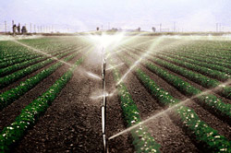
Third Siders and Global Effects
Local Agriculture
Agricultural services surrounding the Great Lakes have historically been given privilege to unlimited water diversion from the waters. Water is desperately needed for food production, but this industry is very water intensive—it accounts for the largest amounts of diversion. Considering their position of privilege, Agricultural players are reluctant to change the current water system.
Local Fisheries
Local fisheries and fisherman also have significant impacts on the Great Lakes—but in a much different way. Fisherman need not divert water to maintain their industry thus dispossession is not an issue. Rather, fisherman want healthy waters and abundant fish populations in order to be successful. Both of these factors have been jeopardized through the tragedy of the commons discussed earlier. Thus, because fisherman realize how the Lakes are currently being threatened, they are more willing to consider change in the water system.

Slide 20
Profiteers
Water Lords
“Water Lords” are the very large and very powerful corporations that aim to obtain large quantities of fresh water to bottle and sell in other regions. By seeking this monetary gain, Water Lords put increased pressure on the Lake ecosystems and other institutions trying to bring about change.
Alternative Systems Developers
This group is the only profiteer on the Commons side of the conflict. These developers are hoping to generate a profit by developing new, and hopefully more sustainable, systems for water management and allocation. They are innovators seeking to reform the current infrastructure that we have.
Hydroelectric Developers
Hydroelectric canals and dams are littered across the Great Lakes landscape. Developers wish to increase these projects to obtain financial gain from the building contracts as well as income from the electricity generated by the projects. These people wish to keep the system the way it is in order to have more freedom to build.
Oil Developers/Drillers
The Great Lakes sit atop massive oil wells and deposits beneath the earths crust. Third parties have always been interested in this oil, but access has remained limited. This party wants to reform the system in the opposite direction, opening the lakes to oil drilling.

Slide 21
Dispute Timeline
Boundary Waters Treaty of 1909
2005 St. Lawrence River
Basin Sustainable Water
Resources Agreement
First international agreement on regulation – Establishes IJC
Based on model that everyone should have a “Convenient Opportunity to be heard”
Has many limitations that will need to be ratified in the future.
1955 Convention On
Great lakes Fisheries
US adds the word “export” to bans on water diversions in the Water Resources Development Act.
IJC further investigates issues of exporting while both Canada and the US agree on a moratorium for exporting water from the Great Lakes.
The negative effects of industrial fishing begin to show in Great Lakes ecosystems.
Creates a government operated Commission for Fishing Management.
1910
1935
1960
1985
2010
1977 Clean Water Act
1985 Great Lakes Charter
1998 Canadian Export Concerns
Mercury contamination in commercial fisheries and eutrophication of lake ecosystems concerns environmentalists.
Clean Water Act established to prevent phosphorous dumping in the Great Lakes watershed.
Introduces new mechanisms for co-managing – step towards an integrated watershed.
Goal is “to provide a secure foundation for future investment and development within the region” – concerning for Environmentalists.
Later Gives rise to the Water Resources Development Act.
Premiere of Canada gives license to private firm allowing them to export 150 million gallons per year – shipped by tanker to Asia for bottling.
Creates a government operated Commission for Fishing Management.

Slide 22
Shortcomings of Current System
Stated goals of the Charter obviously favor economic interests.
Most jurisdictions are concerned only with growth – not preservation.
Definition of Public Trust has undergone radical transformation since it was first introduced.
Concepts of Public Trust aren’t universally embraced or practiced.
    Corporations are given too much authority and power.
Great Lakes Charter
Existing Public Trust Laws
NAFTA Exploits
Great Lakes/St. Lawrence Compact
Environmentalists want to frame ecosystem as primary concern.
Designed to protect against diversion in Great Lakes region.
Bureaucratic loopholes allow for corporations to bypass trading regulations.
Has unforeseen loopholes that allow for companies to pump large amounts of water
Water can be extracted as long as it is described as a “product” and not an “export”.
NAFTA’s “investor state provision” protects foreign companies from changing laws or regulations – firms can take legal action.

Slide 23
Policy Recommendations/Moving Forward
Action
Equity
Communication
-Re-establish consensus on definition of key terms.
-Ensure complete understanding and practice of laws and standards.
-Create uniform regulations between all states and all levels of government.
-Foster the commons notion – water belongs to the people.
-Allow for a hierarchy of power where human needs take precedence.
-Integrate systems and structures to meet needs while compromising interests.
-Establish joint preservation and conservation efforts.
-Create an effective network of public collaboration.
-Carefully manage current structures while allowing growth for new.
Notes:
Defining
Establishing
Building
Cooperating
Belonging

